Slide 1
Cyber Security

Slide 2

This Photo by Unknown Author is licensed under CC BY-NC-ND

Slide 3

CYBER SECURITY
What is a cyber security
cybersecurity is the protection of internet-connected systems such as hardware, software and data from cyberthreats. The practice is used by individuals and enterprises to protect against unauthorized access to data centers and other computerized systems.

Slide 4
Why is cyber security is important ?
With an increasing number of users, devices and programs in the modern enterprise, combined with the increased deluge of data -- much of which is sensitive or confidential -- the importance of cybersecurity continues to grow. The growing volume and sophistication of cyber attackers and attack techniques compound the problem even further.

Slide 5
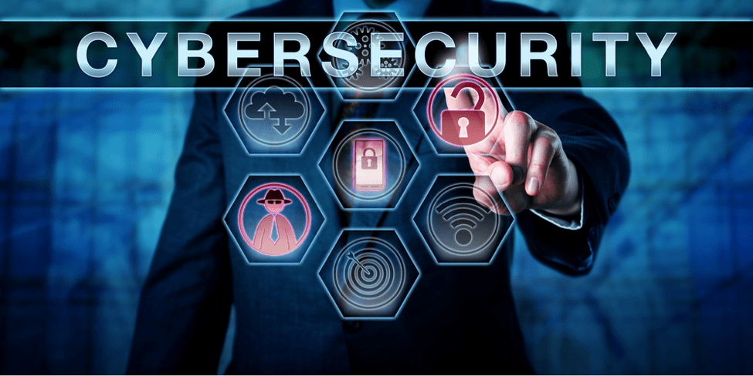
What are the elements of cybersecurity and how does it work?
The cybersecurity field can be broken down into several different sections, the coordination of which within the organization is crucial to the success of a cybersecurity program. These sections include the following:

Slide 6

What are the benefits of cybersecurity?
Business protection against cyberattacks and data breaches.
Protection for data and networks.
Prevention of unauthorized user access.
Improved recovery time after a breach.
Protection for end users and endpoint devices.
Regulatory compliance.
Business continuity.
Improved confidence in the company's reputation and trust for developers, partners, customers, stakeholders and employees.
The benefits of implementing and maintaining cybersecurity practices include:

Slide 7
What are the top cybersecurity challenges? Cybersecurity is continually challenged by hackers, data loss, privacy, risk management and changing cybersecurity strategies. The number of cyberattacks is not expected to decrease in the near future.

Slide 8
Thank you

